Slide 1
Csu cyberrange expansion – 04/24/2026
By Joshua Ingalls
B.S Cybersecurity
Dr. Julie Henderson

Slide 2
Statement of purpose
My purpose for this project is to create a virtual environment where Freshman/Sophomore Cybersecurity students can learn the basic principles needed for cyber competitions. Students will be able to enumerate and explore networks, navigate Command Line Interfaces, Establish Firewall rules against attacking IP

Slide 3
Research & background
Researched existing competition environments from previous SECCDC and PCDC environments
Researched current infrastructure of the current CSU Cyberrange
Explored different Linux and Windows environments for project usage
Delved into network connectivity

Slide 4
Project language(s), software, and hardware
Virtural box
Windows 10 machine
4 Ubuntu LTX machines
Wireshark
Nmap

Slide 5

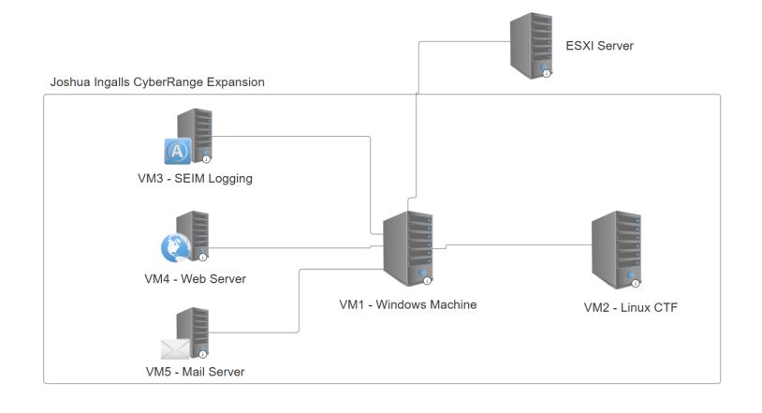
Network Diagram
5 total VMs
Windows 10 Host Machine
SIEM VM
Web Server
Mail Server
Capture the Flag

Slide 6
Test Plan
Network Connectivity
Firewall Rules
User & Password Policy
CTF Flags
Port Scanning
Student Usability with live demos

Slide 7
Live Demo
Time to enter the range!

Slide 8
Challenges overcome
Attempted Python launching
Network connectivity issues
Configuration issues
File corruption
Github size limits

Slide 9
Future enhancements
Upgraded tasks for Junior/Senior level students
More virtual machines for attacker roles
Upgraded capability on existing VMs

